Slide 1
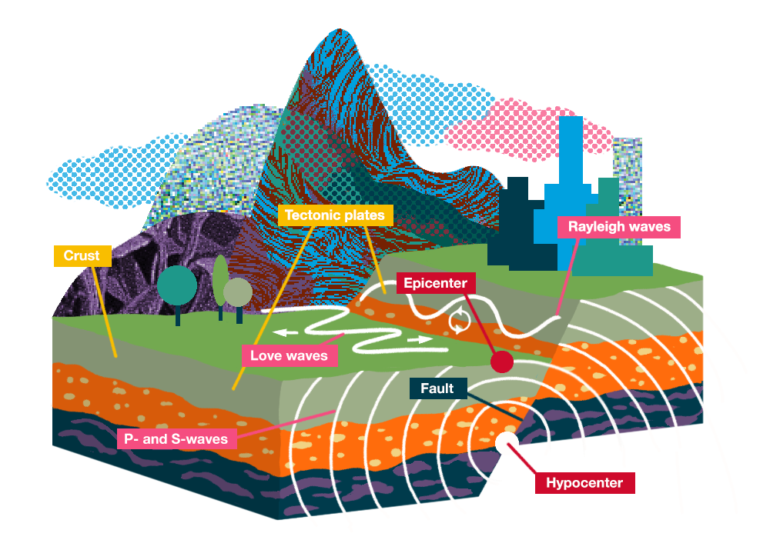
Earthquake Prediction Analysis
By: -Dilip Kumar

Slide 2
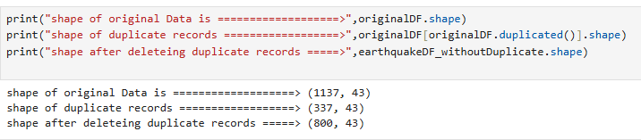
Sanity Check & Data Cleaning
Total no of records are 1137 and 43 columns.
Duplicate Records are 337
Deleted 23 Features (place, sources, types, placeOnly, title, time, updated, status, continent, country, subnational, city, id, type, url, detailUrl, code, ds, geometryType, what3words, locationDetails, postcode, timezone)

Slide 3
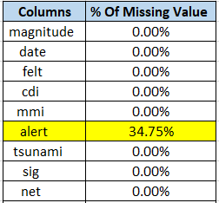
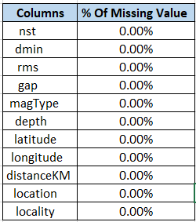
Sanity Check & Data Cleaning
Note: Deleted continent, country, subnational, city because it has multiple missing values. These
Details can be derived from latitude and longitude.
Performed Missing Value imputation on alert feature.
How? As it’s a non-numeric field and replaced the mssing values with the mode of the alert column

Slide 4
Data Preparation Before Training The model
Performed one hot encoding on ‘Alert’ feature to covert 4 separate zones( Green, Red, Yellow, Orange)
How? One Hot Encoding has been done using panda’s getdummy method.
Splitted Data feature in to “Date” and “Time” to simplify the data.
Removed hyphen (–) from locality.
Performed “Label Encoding” on locality field
Why? Considering this is a dependent filed, this model will predict that the certain locality will be impacted
by earthquake or not.

Slide 5
Data Preparation Before Training The model
Converted all categorical features in to numerical using one hot encoding technique and Ensemble Selection.
How?: Find the most frequent categories of a feature and select top 10 (in this case, count may vary) and perform one hot encoding, keep other categories by default zero (0).
After performing encoding on all the categorical columns the data shape is 800, 84 which is higher hence next step is to perform PCA

Slide 6
Steps Performed While Doing PCA
Standardizing the data
Compute the covariance matrix
Calculating the eigenvectors and eigenvalues
Scaled the standardized data using StandardScaler()
Performed PCA for Dimensionality Reduction to reduce the column from 800,84 to ?
.Checked Explained Variance Ratio
Calculated Explained Variance to plot using Kaiser Method
Plot the graph using Elbow Method and Kaiser Method to check what is the best dimension we can use

Slide 7
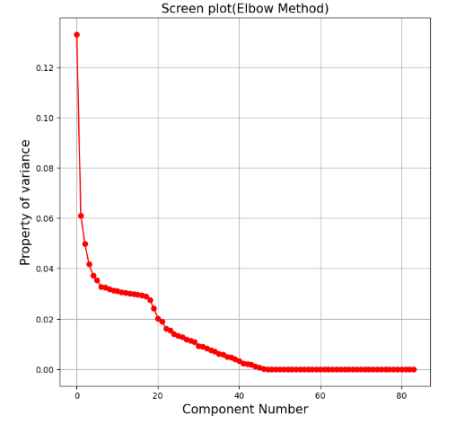
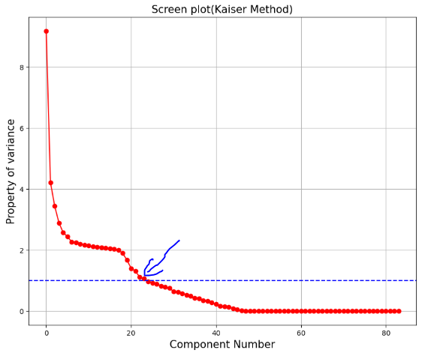

Slide 8
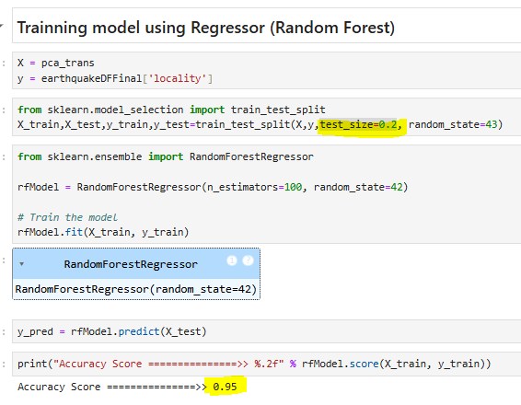
Trained The Model using Regressor
Model was trained on Random Forest Regressor Model
Assumed Dependent variable is “Locality”
n_estimators=100
test_size=0.2

Slide 9
Observations

Slide 10
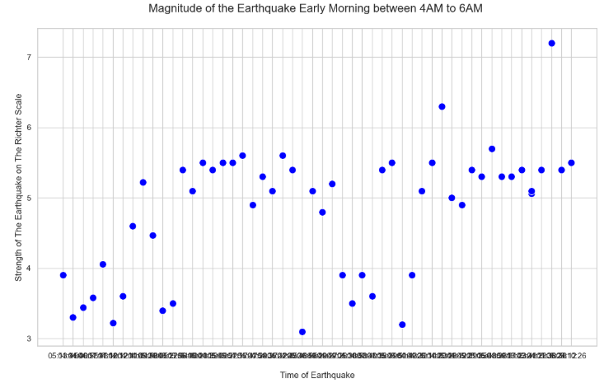

Slide 11
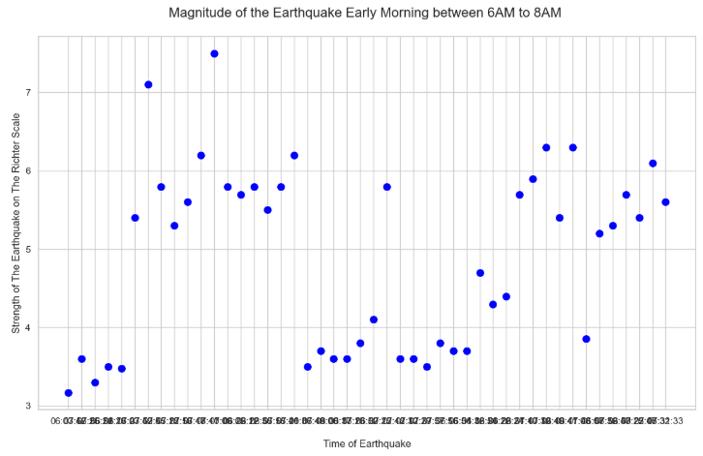

Slide 12
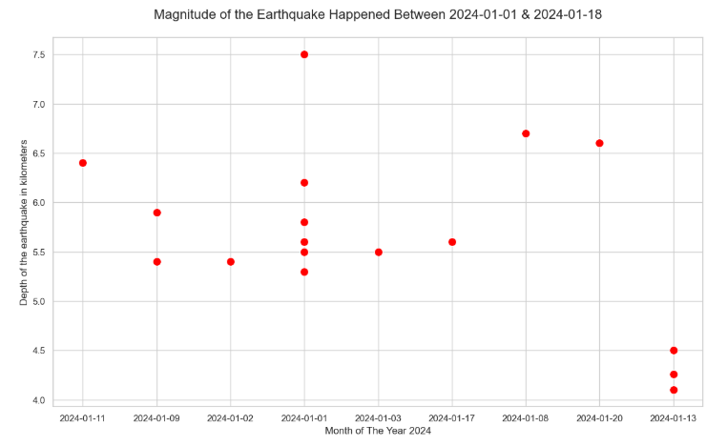

Slide 13
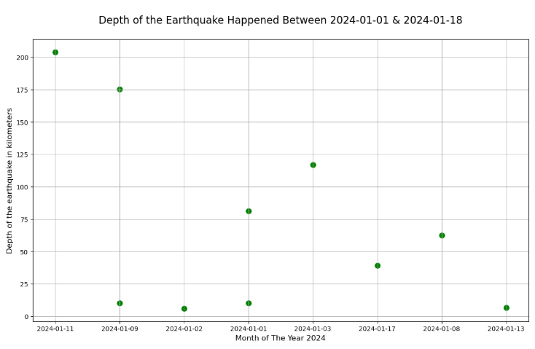

Slide 14
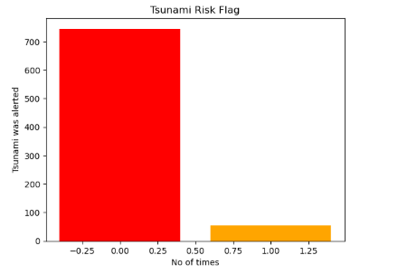

Slide 15
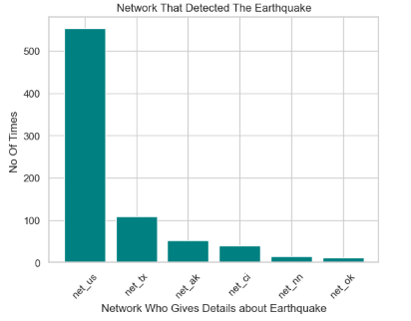

Slide 16
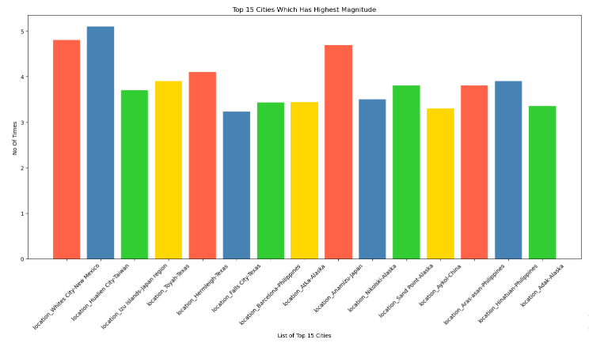

Slide 17
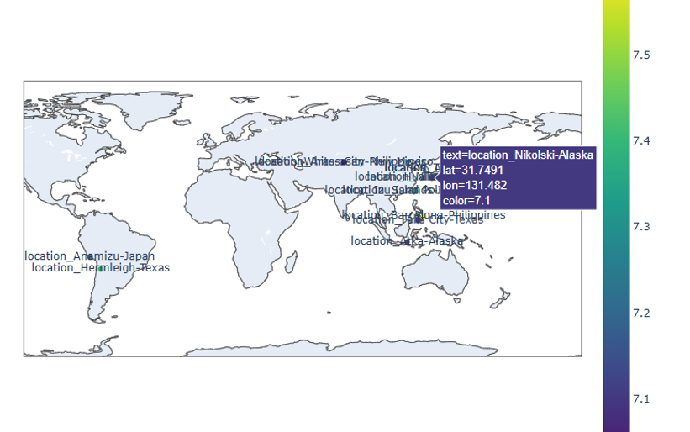

Slide 18
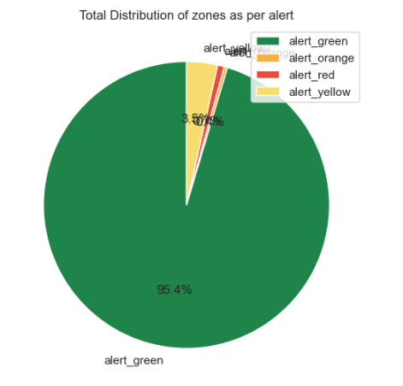

Slide 19
Thank You

